Slide 1
JS Course
Arabic Edition – باللغة العربية
Presented By: Ramy Ibrahim

Slide 2
Course Outlines
Introduction
Programming Concepts
Browser Components
JavaScript Basics
Advances JavaScript Concepts
Project

Slide 3
Programming Concepts
Programming
Use of Memory
JS in browser
JS as Server-side language
Types
Object as Type

Slide 4
Hello World
Dev Tools
JS is a high level, object-oriented, multi-paradigm programming language
Frameworks can go , JS can’t

Slide 5
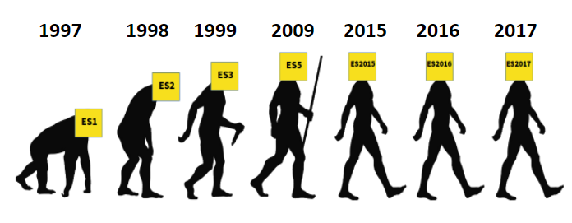

What is JavaScript?
ES2015 | 6
ES2016 | 7
ES2017 | 8
ES2018 | 9
ES2019 | 10
ES2020 | 11
ES2021 | 12
European Computer Manufacturers Association (ECMA)

Slide 6
Topics to discuss
Linking files
Values and Variables
Data types
Primitive
Number (float)
String
Boolean
Undefined, Null
Symbol (Unique values) ES6
BigInt ES11
Object
Let, Const and Var

Slide 7
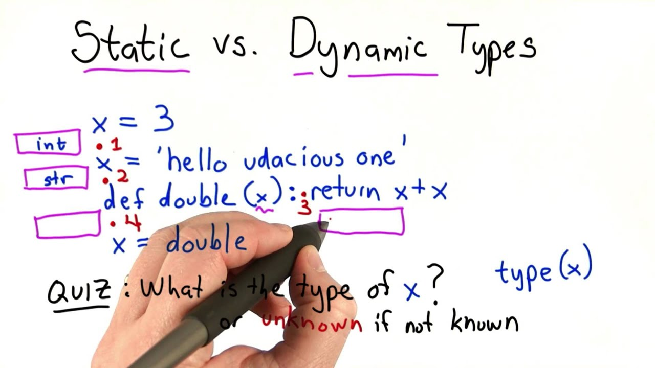
Dynamic type vs Static type

Slide 8
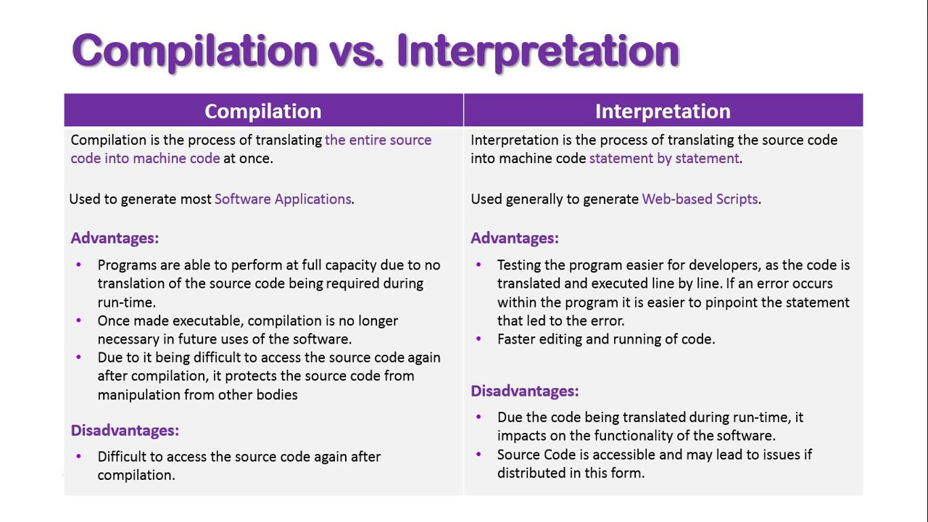
Compilation vs Interpretation

Slide 9
Topics to discuss
Typeof
Null is an object
Basic Operations (Arithmetic) +, -, *, **,/
Assignment Operator =, +=, -- ,++ ,
Logical
Operator Precedence MDN

Slide 10
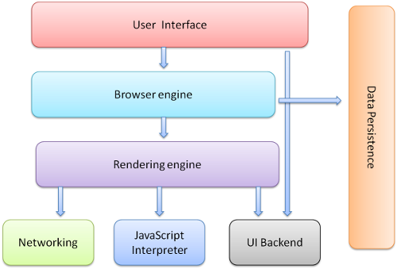
Browser Components
User Interface: search bar, back button, etc.
Browser Engine: Bridge connecting UI and Rendering engine (logic layer)
Rendering engine converts code into page
Networking: responsible to get resources and communicate with APIs
Data Persistence: Store cookies and IndexDB, WebSQL, Local Storage, etc.
UI Back-end: Logic code for UI actions
JavaScript Interpreter: executes JS code

Slide 11
Document
Get Element By Id
Access value
Convert value

